Slide 1
IPL DATA ANAYIS 2022
R language

Slide 2
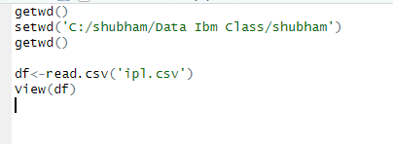
Part 1 st Read import the csv file

Slide 3
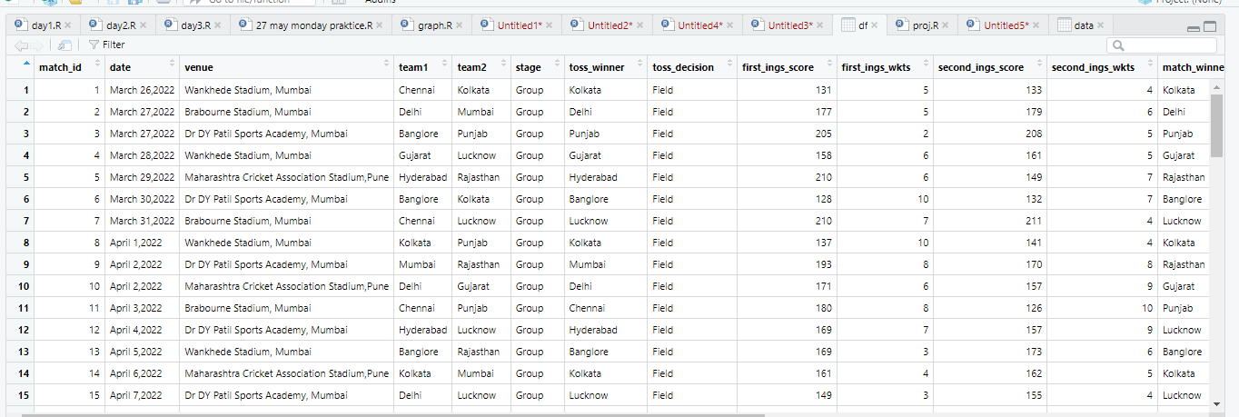
OUTPUT CSV FILE

Slide 4
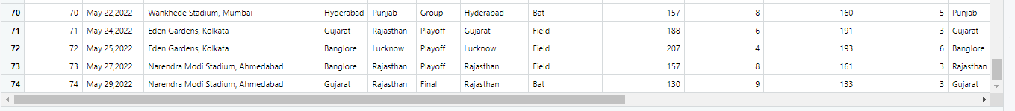
Df.tail()

Slide 5
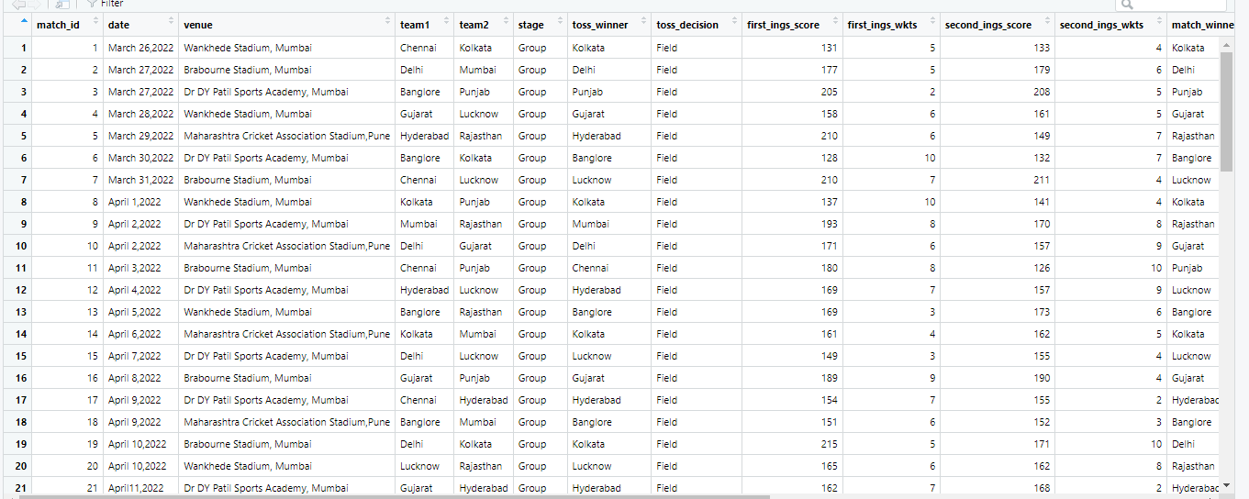
Check The Null Values
is.null(df)

Slide 6
Check The Duplicated Column
sum(duplicated(df))

Slide 7
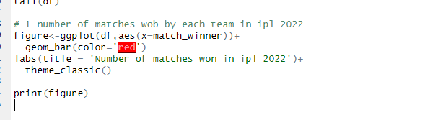
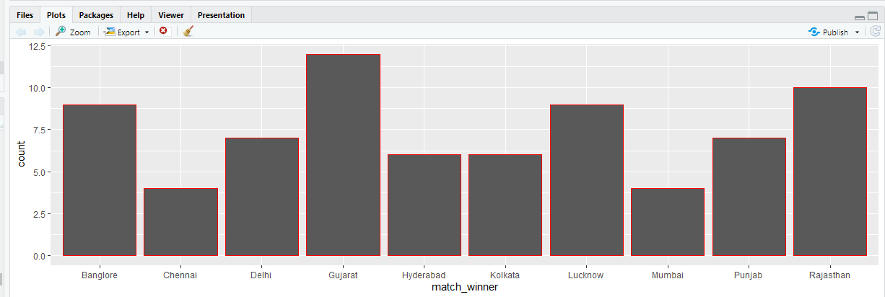
1.Number Of Matches Wob By Each Team
Gujrat
Rajstan
Banglore

Slide 8
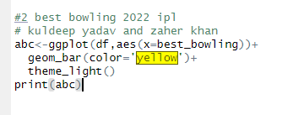
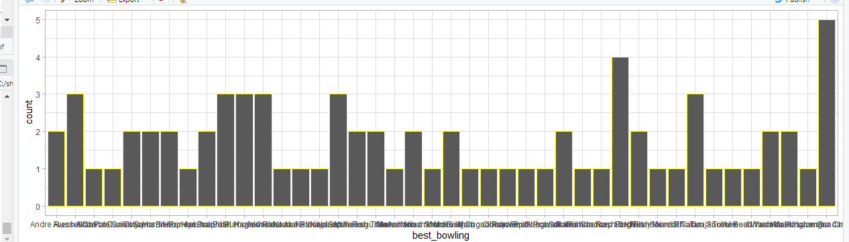
Best Bolwer_2022 ipl
Kuldeep Yadav
Zaheer Khan

Slide 9
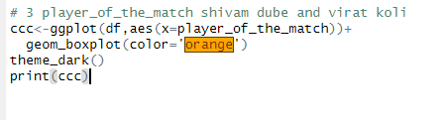
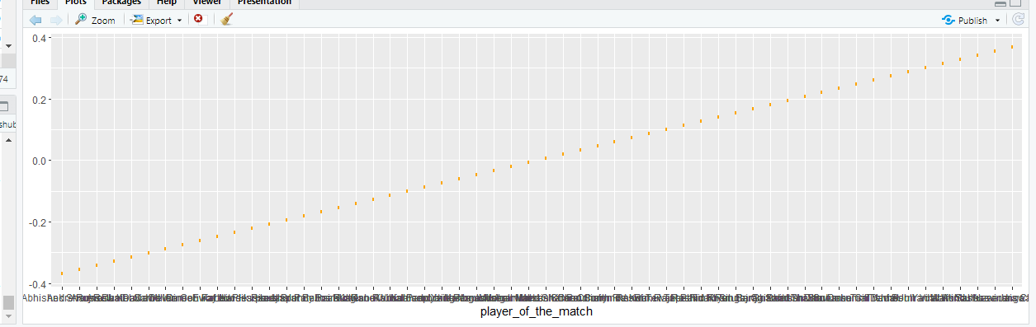
3.Plyear of The match
Shivam Dube
Virat kohli

Slide 10
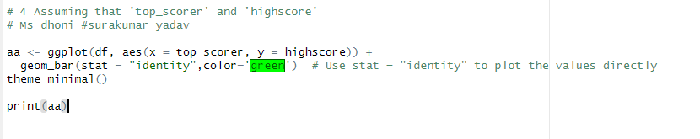
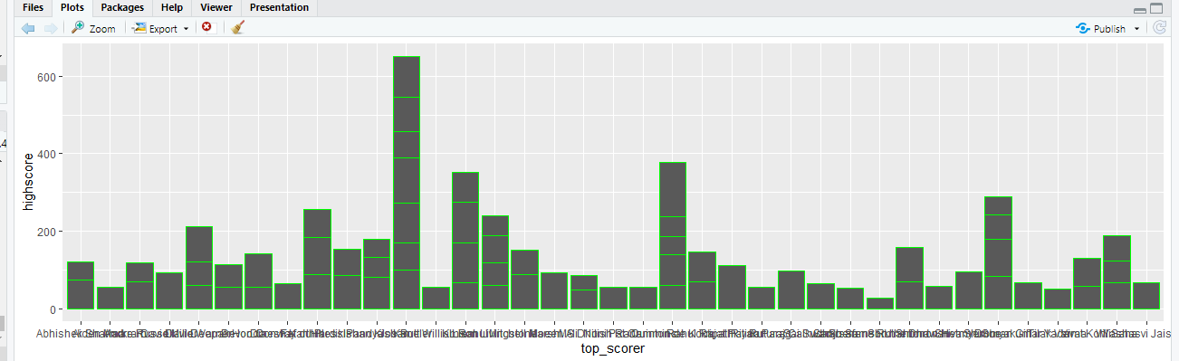
4.Assuming top score High Score
Ms Dhoni
Surakumar Yadav
658 runs
358 Runs

Slide 11
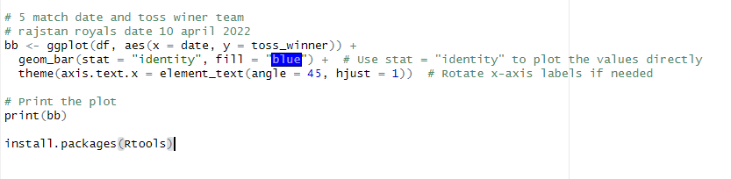
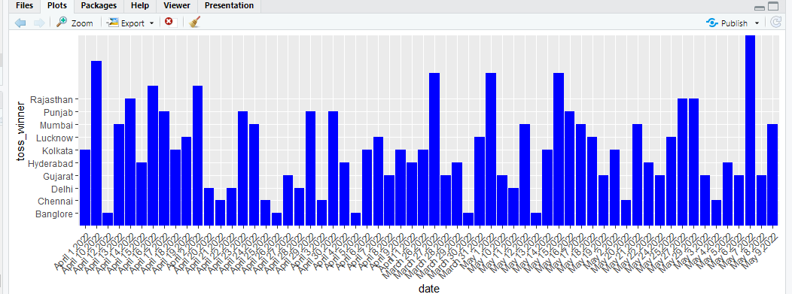
5.Toss wineer team max time and date
Rajstan Rolles
7th may 2022

Slide 12
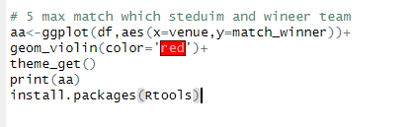
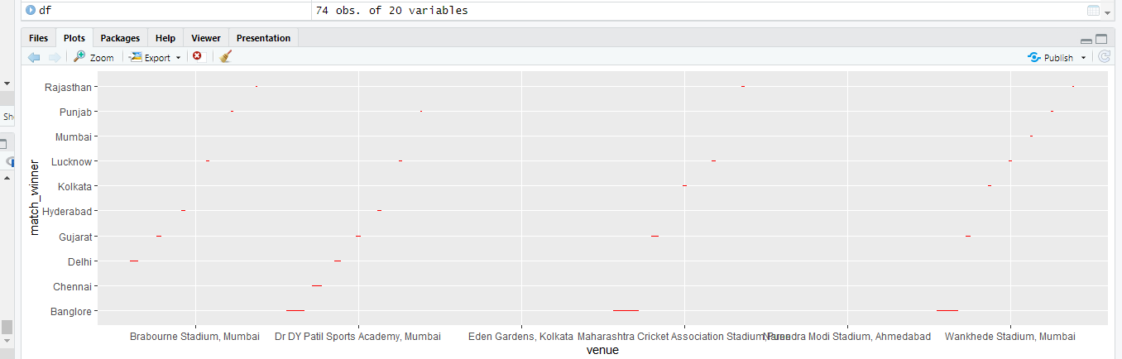
6.Max the stedium match which team is winner
Wankhede Stadium, Mumbai
Banglore Team

Slide 13
Function Use
1.getwd
2.setwd
3.df
4.view
5.tail
6.is.null
7.duplicated
8.Bar plot
9.theme_classic
10.Color red
11.theme_light
12.yellow
13.Box plot
14.Orange color
15.theme_dark
16.theme_minimaal
17.Green color
18.blue
19.Violin plot
20.theme_get

Slide 14
ocction
Gujrat,Rajstan and Banglore 2022 ipl is winner .Best Boiwer Kuldeep Yadav and Zaheer khan plyer of virat kholi the match top batsmean ms dhoni 658 runs and surakumar Yadav 358 runs .
Rajstan royles is maxtime toss_winner 7may 2022 max time match pay wankhade stadiunm Mumbai.

